Slide 1
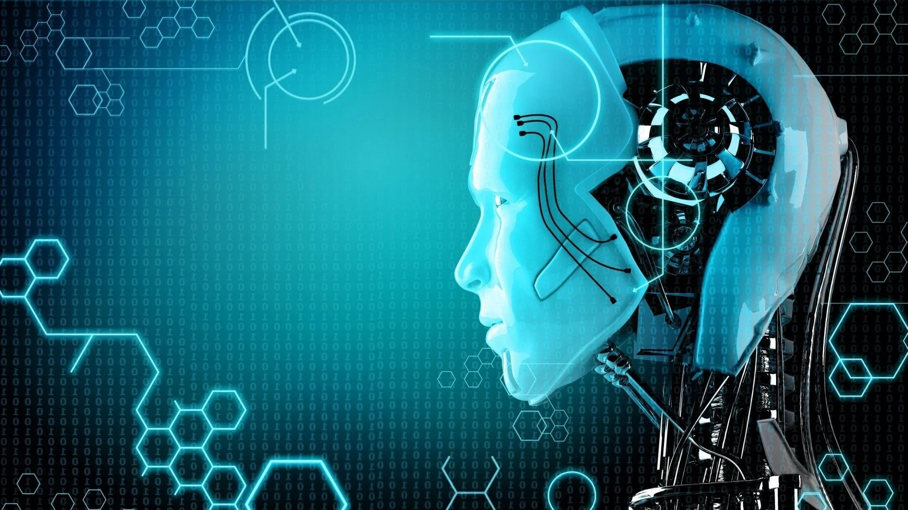
AI for all
RNN > Recurrent neural network
Specially in Text
Ex:-
يعرف معني الكلمة من السياق
Play يلعب - مسرحية

Slide 2
AI for all
Best applications of RNN:
speech recognition
Natural language processing

Slide 3
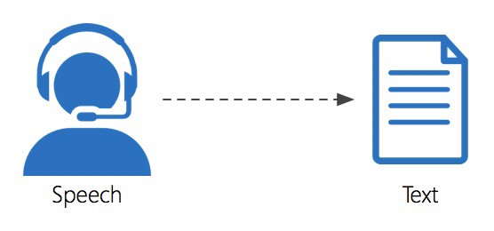
AI for all

Slide 4
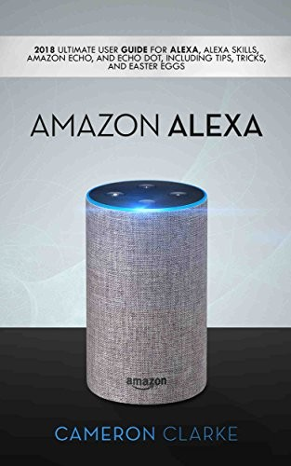
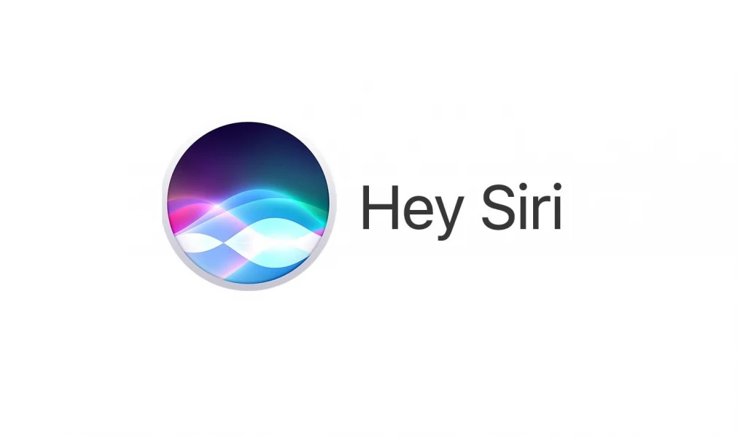
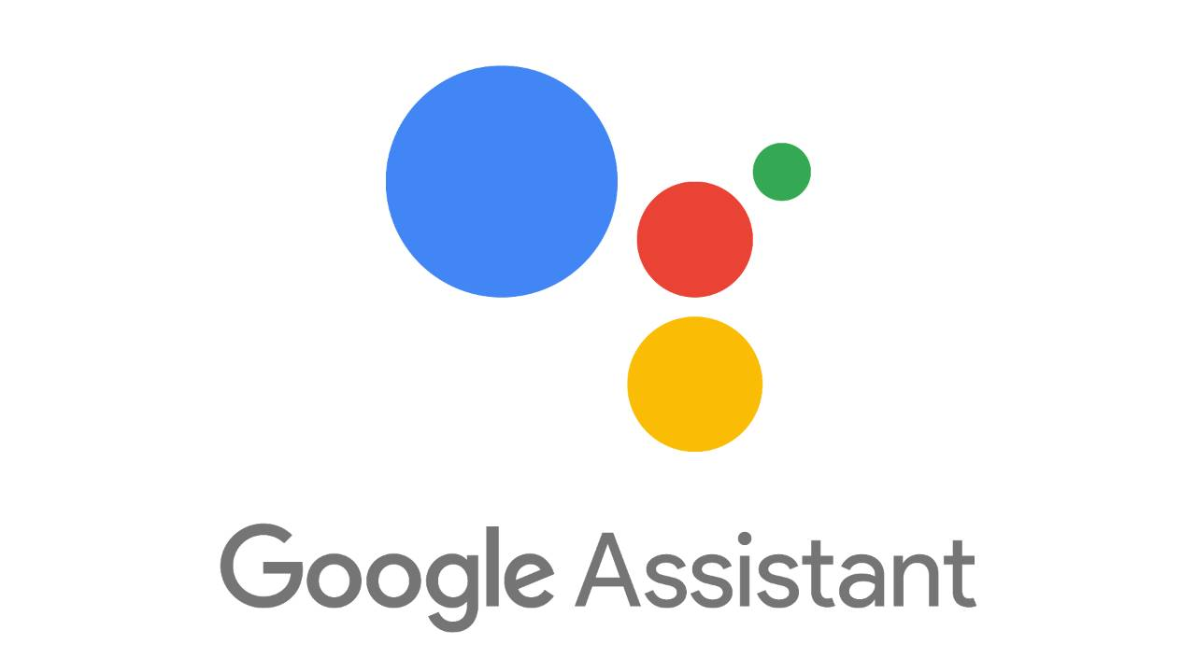
AI for all

